Slide 1

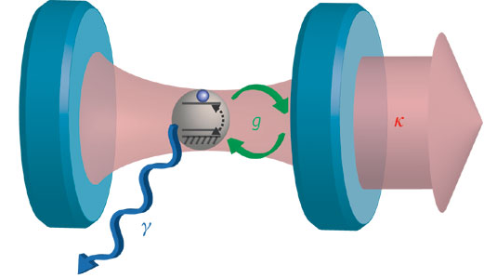

Force on an atom in a cavity and the
Abraham-Minkowski paradox
1/16
June 25 2012 Committee Meeting
Nick Miladinovic
Duncan O'Dell

Slide 2


Motivation
2/16
100 year old problem
1.
Abraham, Max (1909), "Zur Elektrodynamik bewegter Körper", Rendiconti del Circolo Matematico di Palermo 28: 1–28
2.
Minkowski, Hermann (1908), "Die Grundgleichungen für die elektromagnetischen Vorgänge in bewegten Körpern", Nachrichten von der Gesellschaft der Wissenschaften zu Göttingen, Mathematisch-Physikalische Klasse: 53–111

Slide 3
Outline
3/16
Argument for Abraham
Argument for Minkowski
Delta-model
Forces on an atom
Comparing the two
Next steps
Conclusion

Slide 4
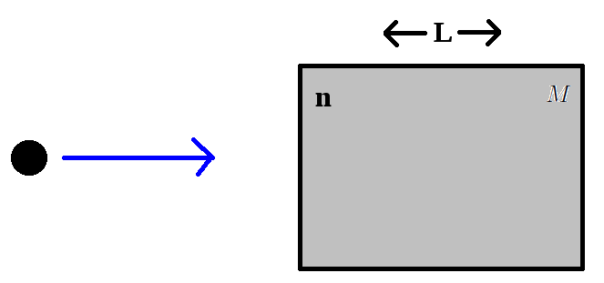

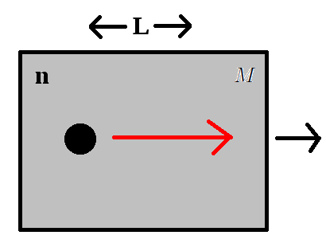



Abraham
4/16

Slide 5
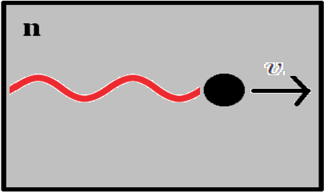




Minkowski
5/16
+

Slide 6
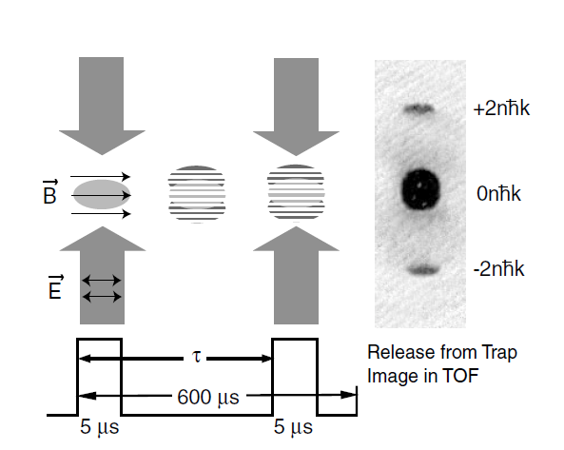
A cold atom recoil experiment giving the Minkowski result
6/16

Slide 7
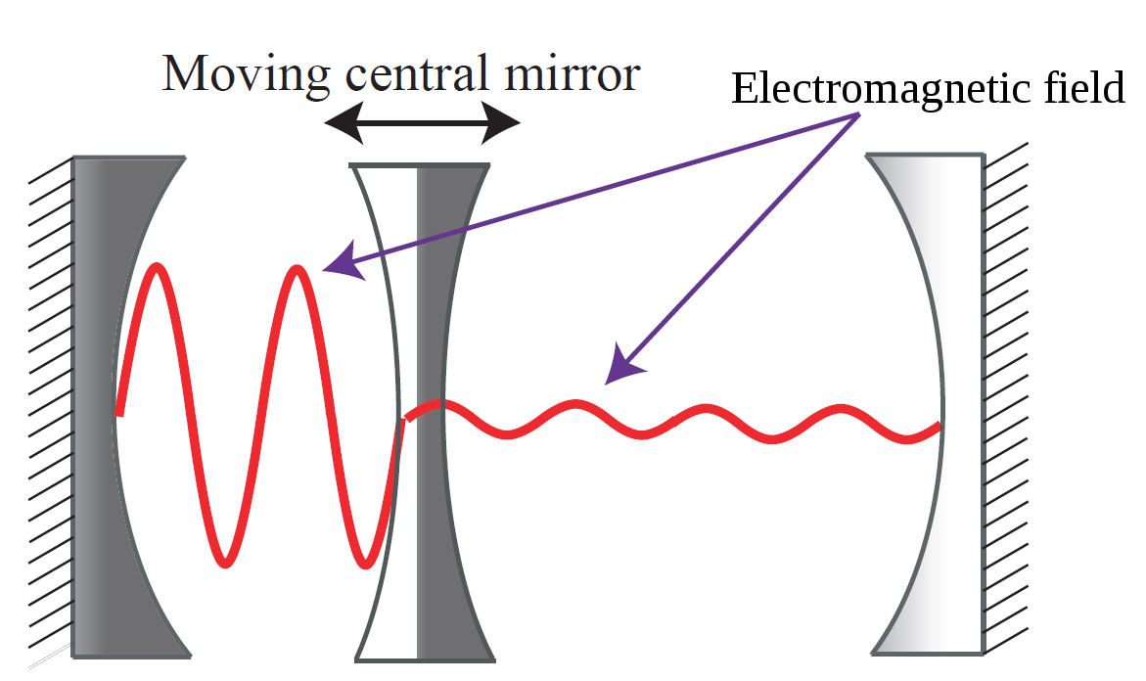
Our Setup
7/16
We call this an “Optomechanical System”

Slide 8


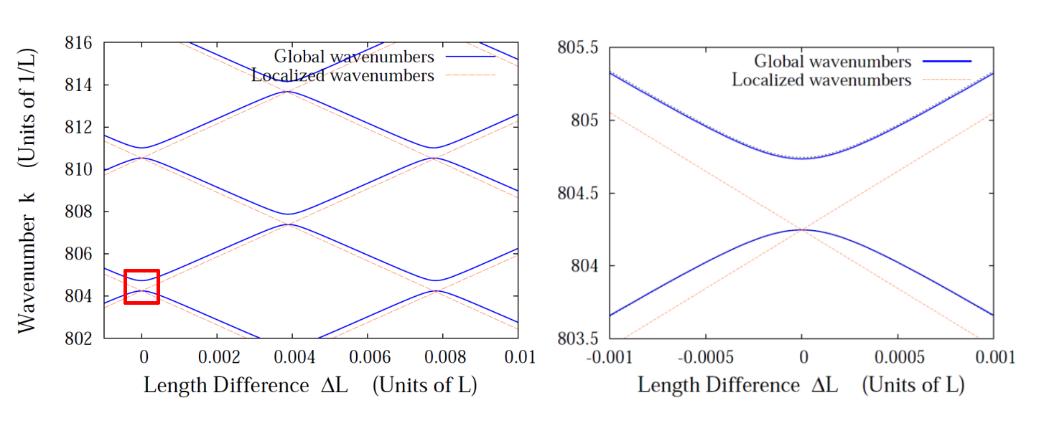
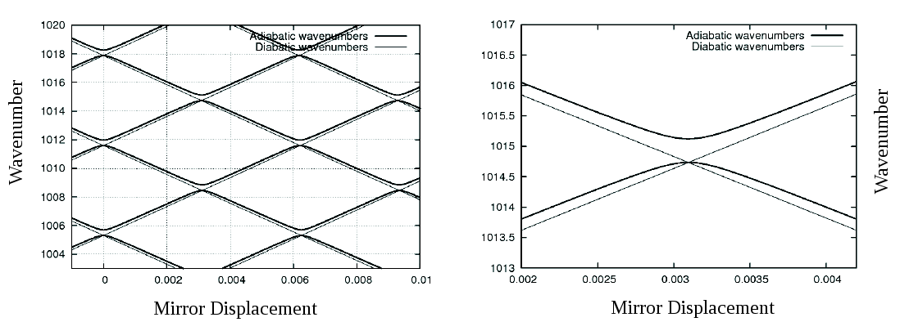
Maxwell's Equations
8/16

Slide 9
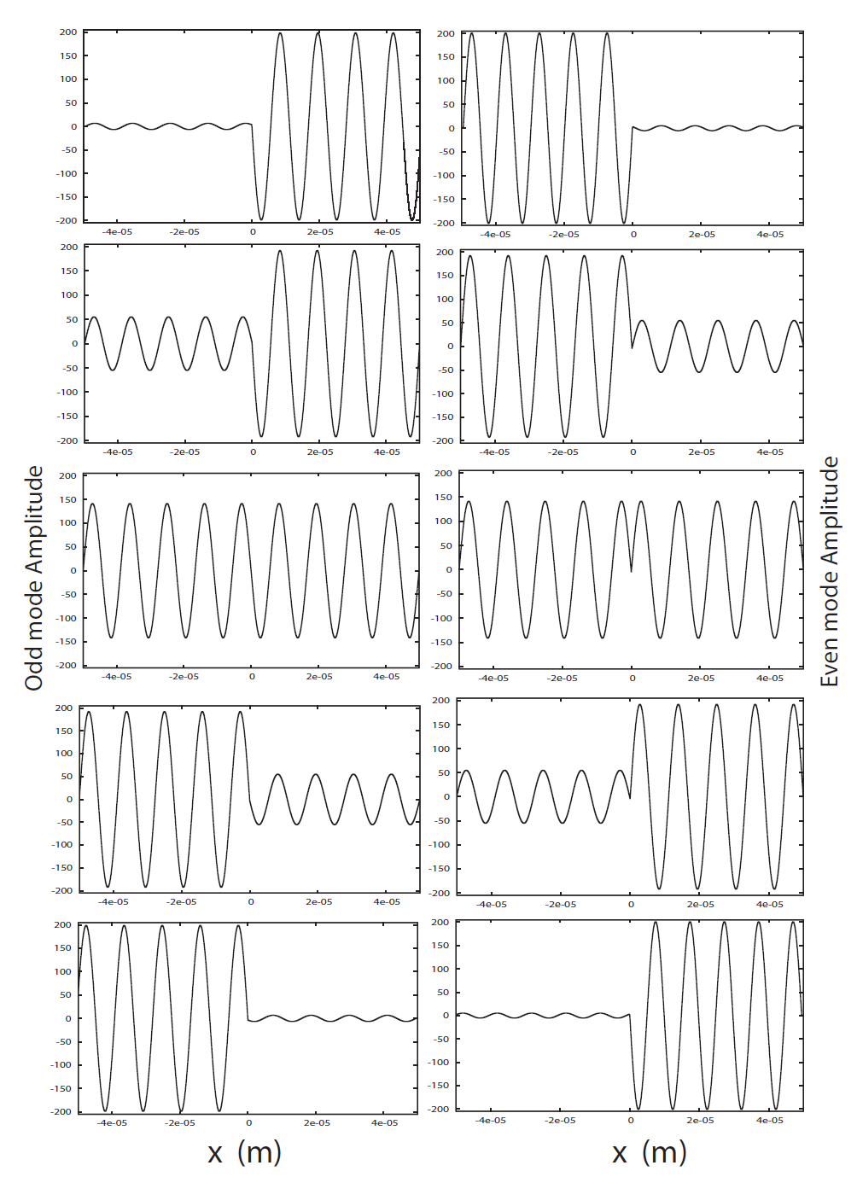
Mode Plots vs. Mirror Position
9/16
Odd Mode
Even Mode
Left Displaced
Mirror
Amplitude
Slightly Left
Displaced Mirror
Central
Mirror
Position
Centered
Mirror
Slightly Right
Displaced Mirror
Right Displaced
Mirror

Slide 10
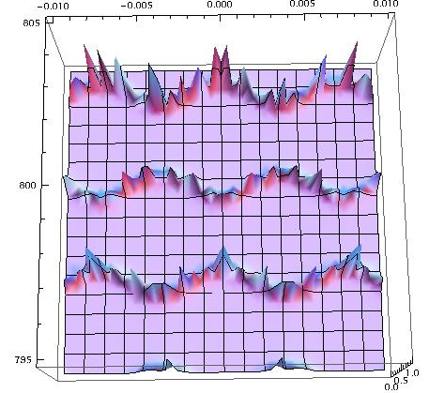
Open vs. closed cavity
10/16
Mirror displacement
Wavenumber

Slide 11

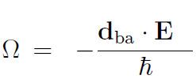


Microscopic expression for an atom and a mirror
11/16
Dipole force
Reflection probability for a single atom
Reflection probability for a single atom
Reflection probability for delta model

Slide 12
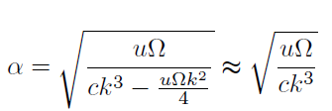


Mapping onto our model
12/16
Solving for alpha
Wavenumber approximation
Atom-cavity refractive index

Slide 13
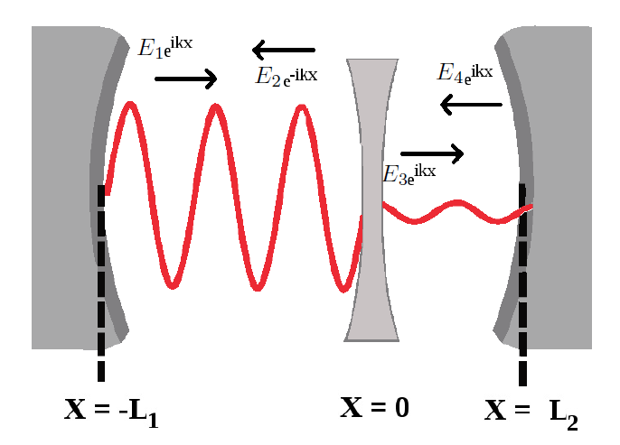

A second approach
13/16

Slide 14
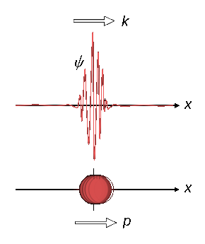
Future Work
14/16
Consider the atom and mirror with a wave function, and see whether we obtain Minkowski or Abraham

Slide 15
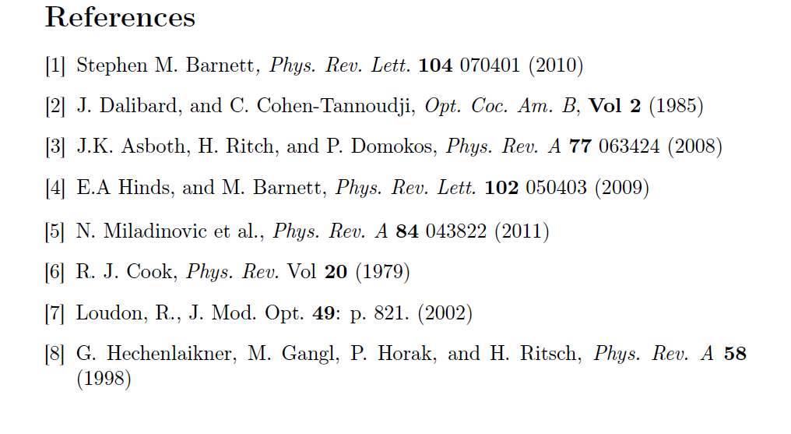
References
15/16

Slide 16
16/16
Thanks!

Slide 17
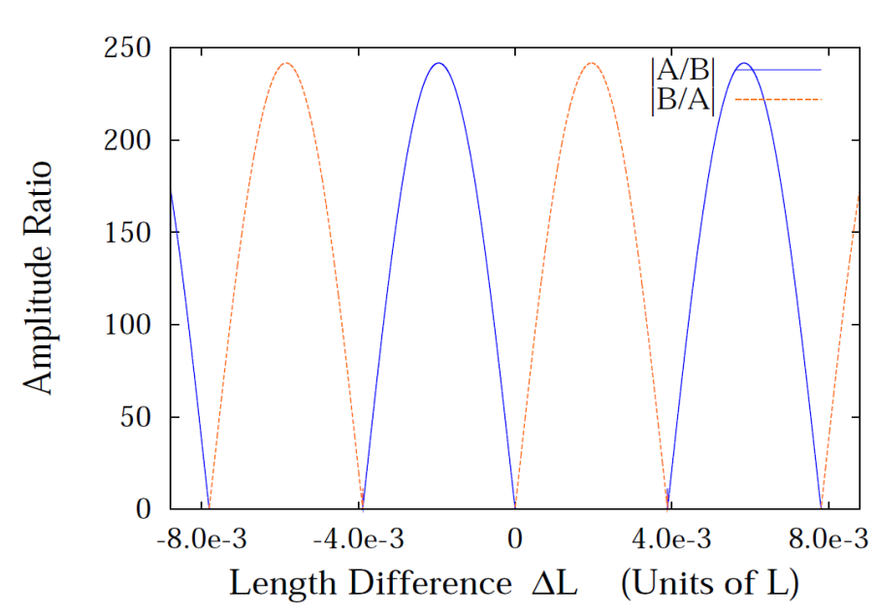
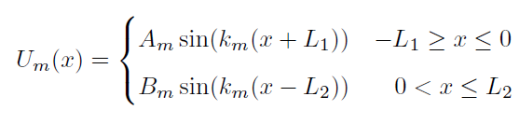
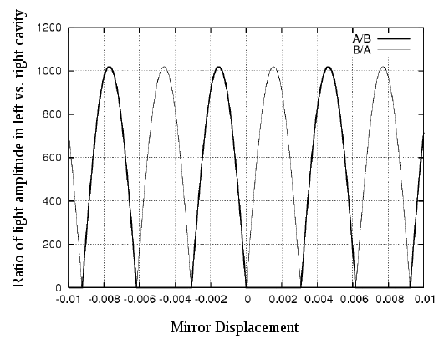
Amplitude Transfer
17/16
Using reasonable parameters we can easily obtain relative amplitude transfers in the range of 1:240
Cavity length L=100 microns
n = 124
alpha = 0.3L

